Slide 1
Lecture Notes: Image Blending and Compositing

Slide 2
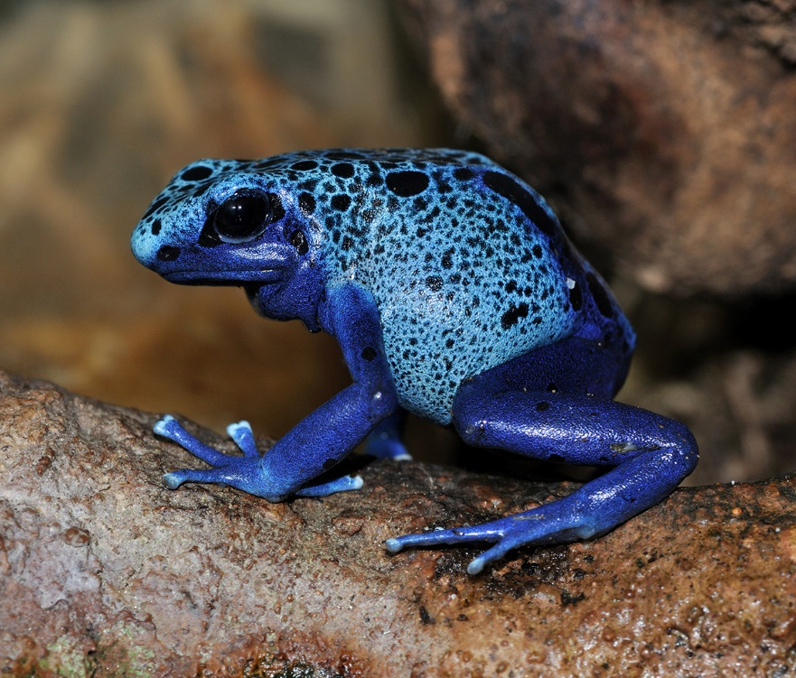
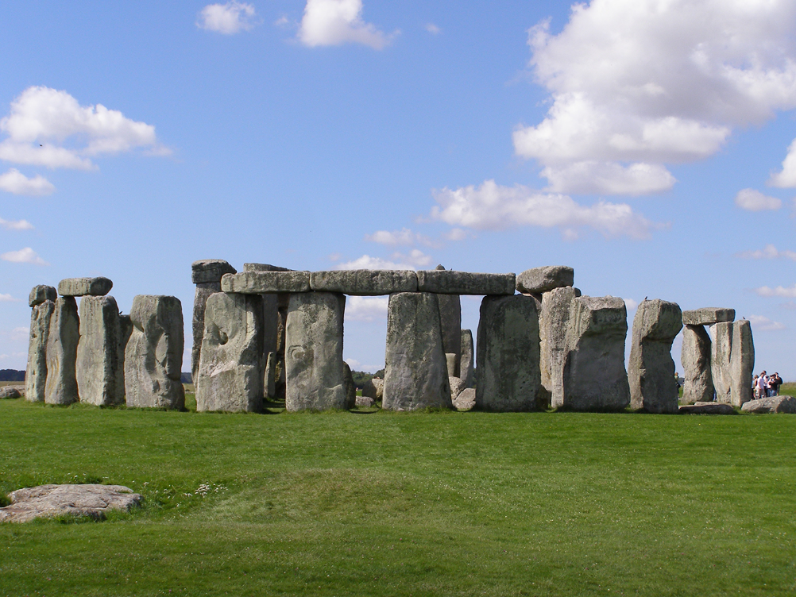
Image Compositing via Resolution Pyramids
Place the Dendrobates Azureus in front of Stonehenge.
Left: Blue Poison Dart Frog (Dendrobates Azureus) in the Frankfurt Zoo, Germany, by Wikimedia contributor, Quartl.
Right: Stonehenge from the north, by Gaerth Wiscombe, http://flickr.com/photos/10173199@N03/1071477228.

Slide 3
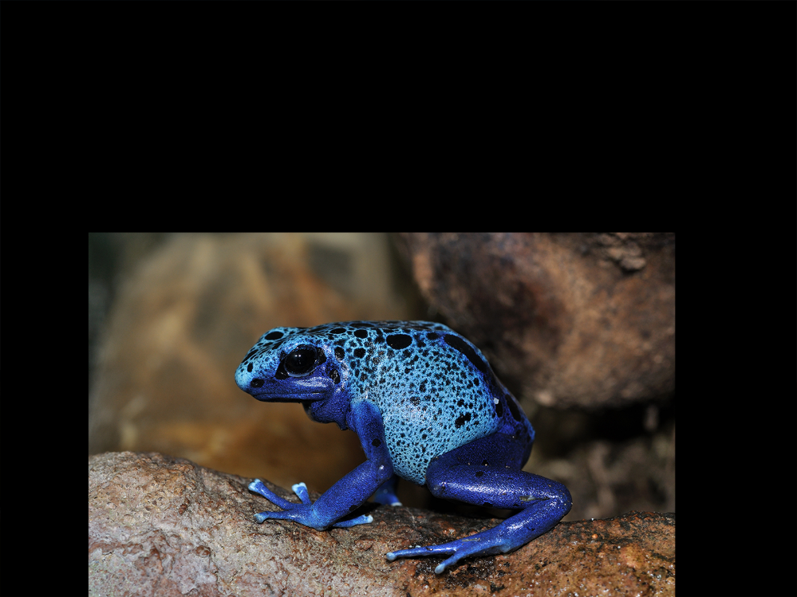
Image Compositing via Resolution Pyramids
Resize the foreground image and place it in a zero image the same size as the background image.

Slide 4
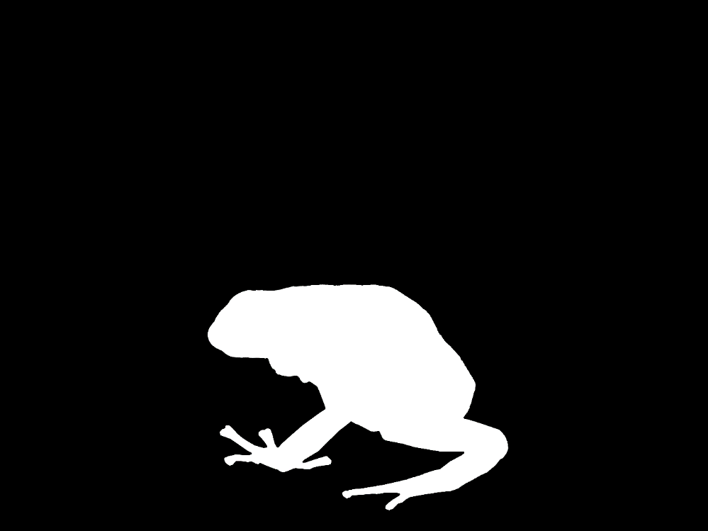
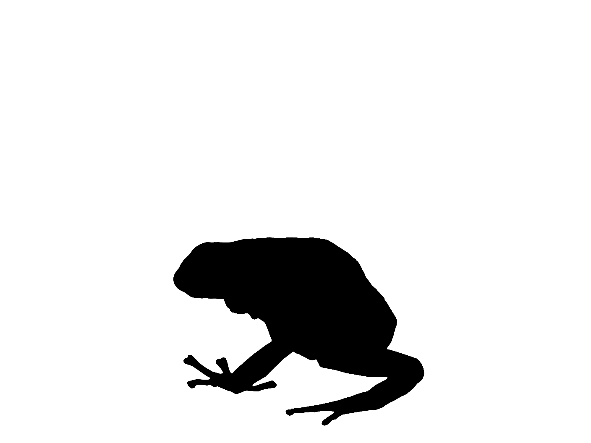
Image Compositing via Resolution Pyramids
Create a binary mask to extract the foreground object and to zero out the corresponding area in the background.

Slide 5
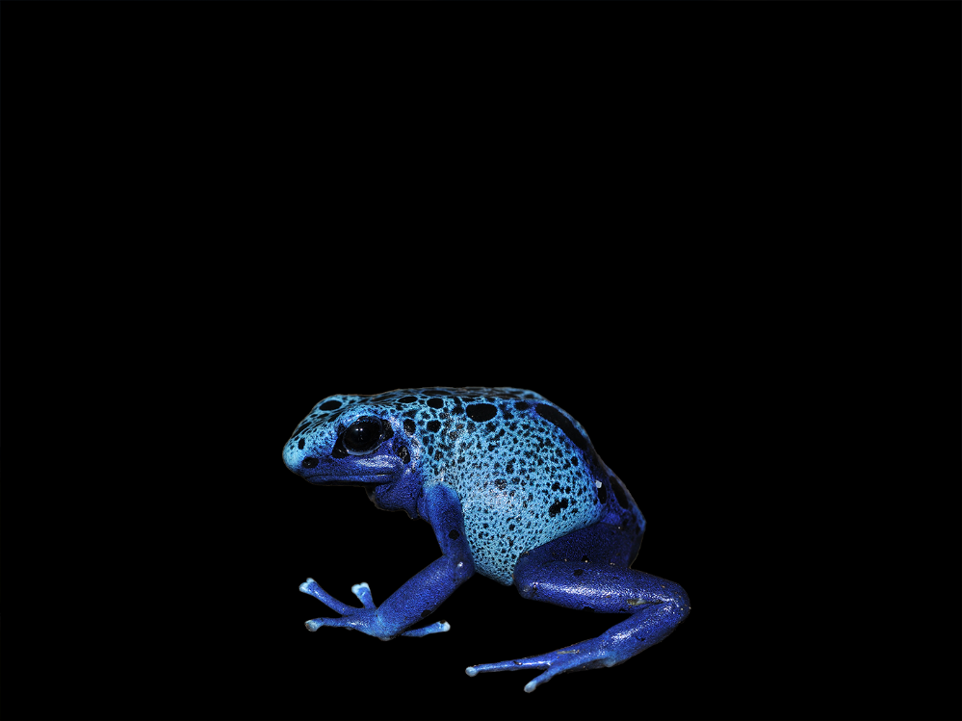
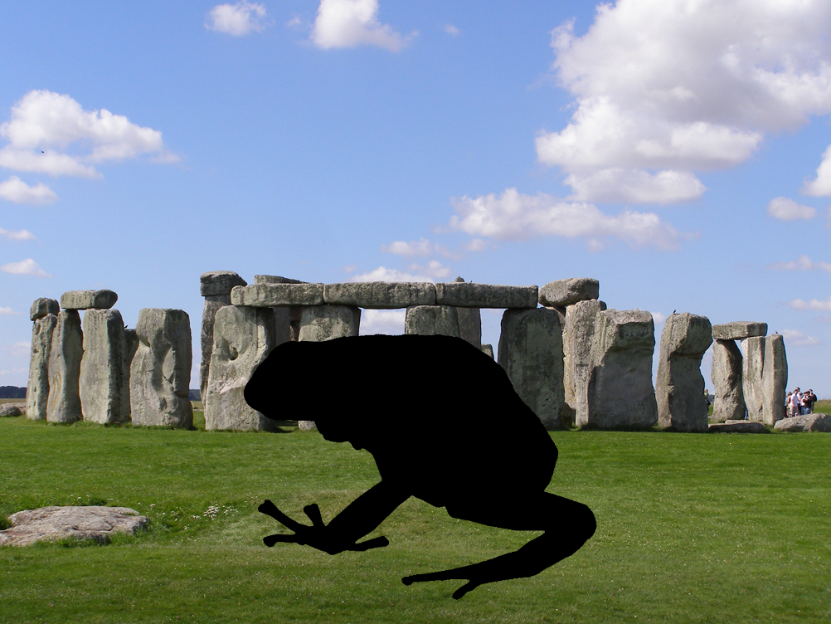
Image Compositing via Resolution Pyramids
Apply the masks

Slide 6
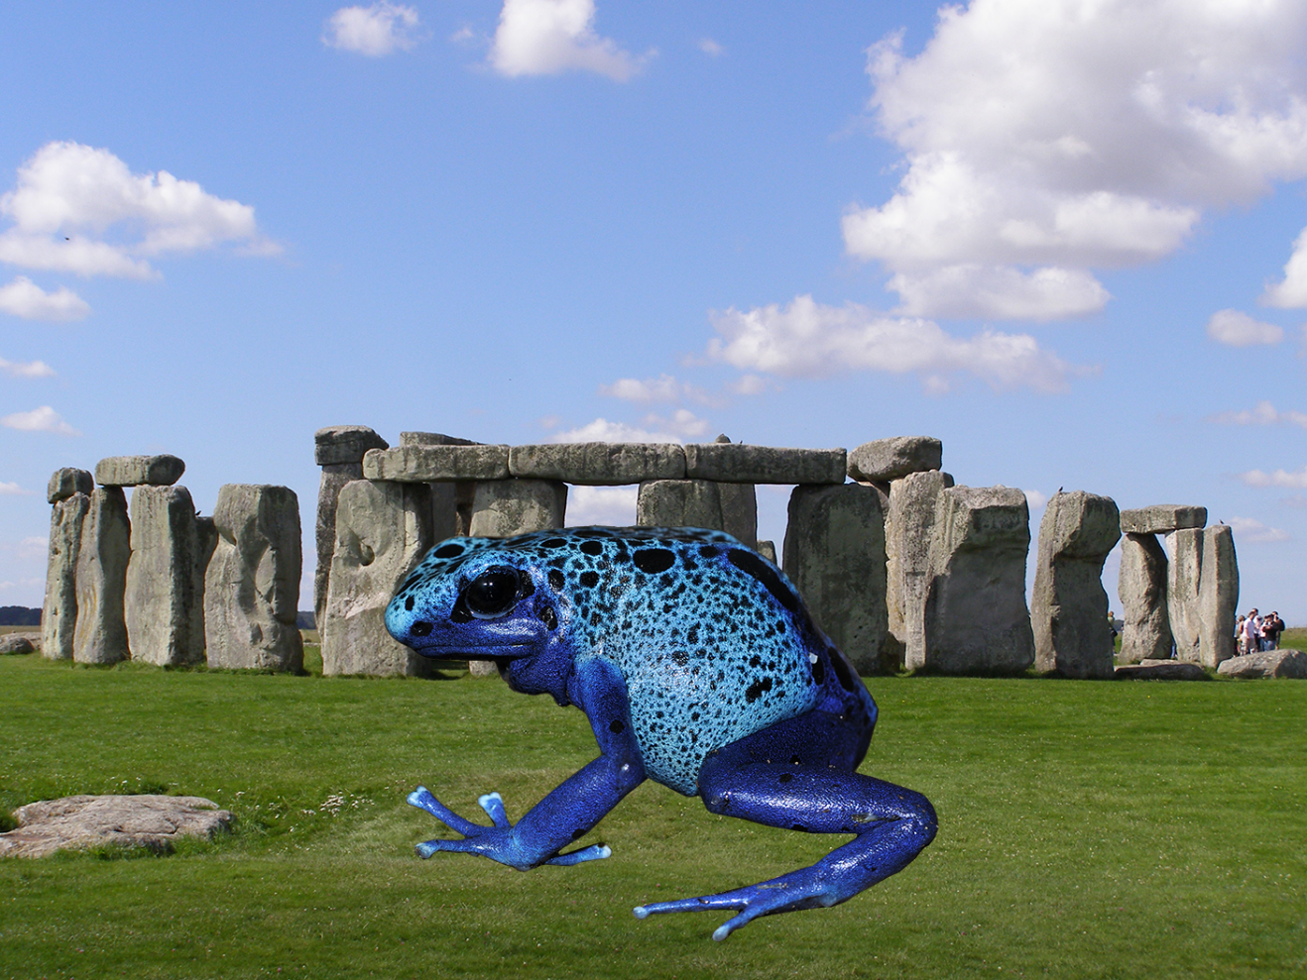
Image Compositing via Resolution Pyramids
This is a simple overlay of the frog on the Stonehenge image.

Slide 7
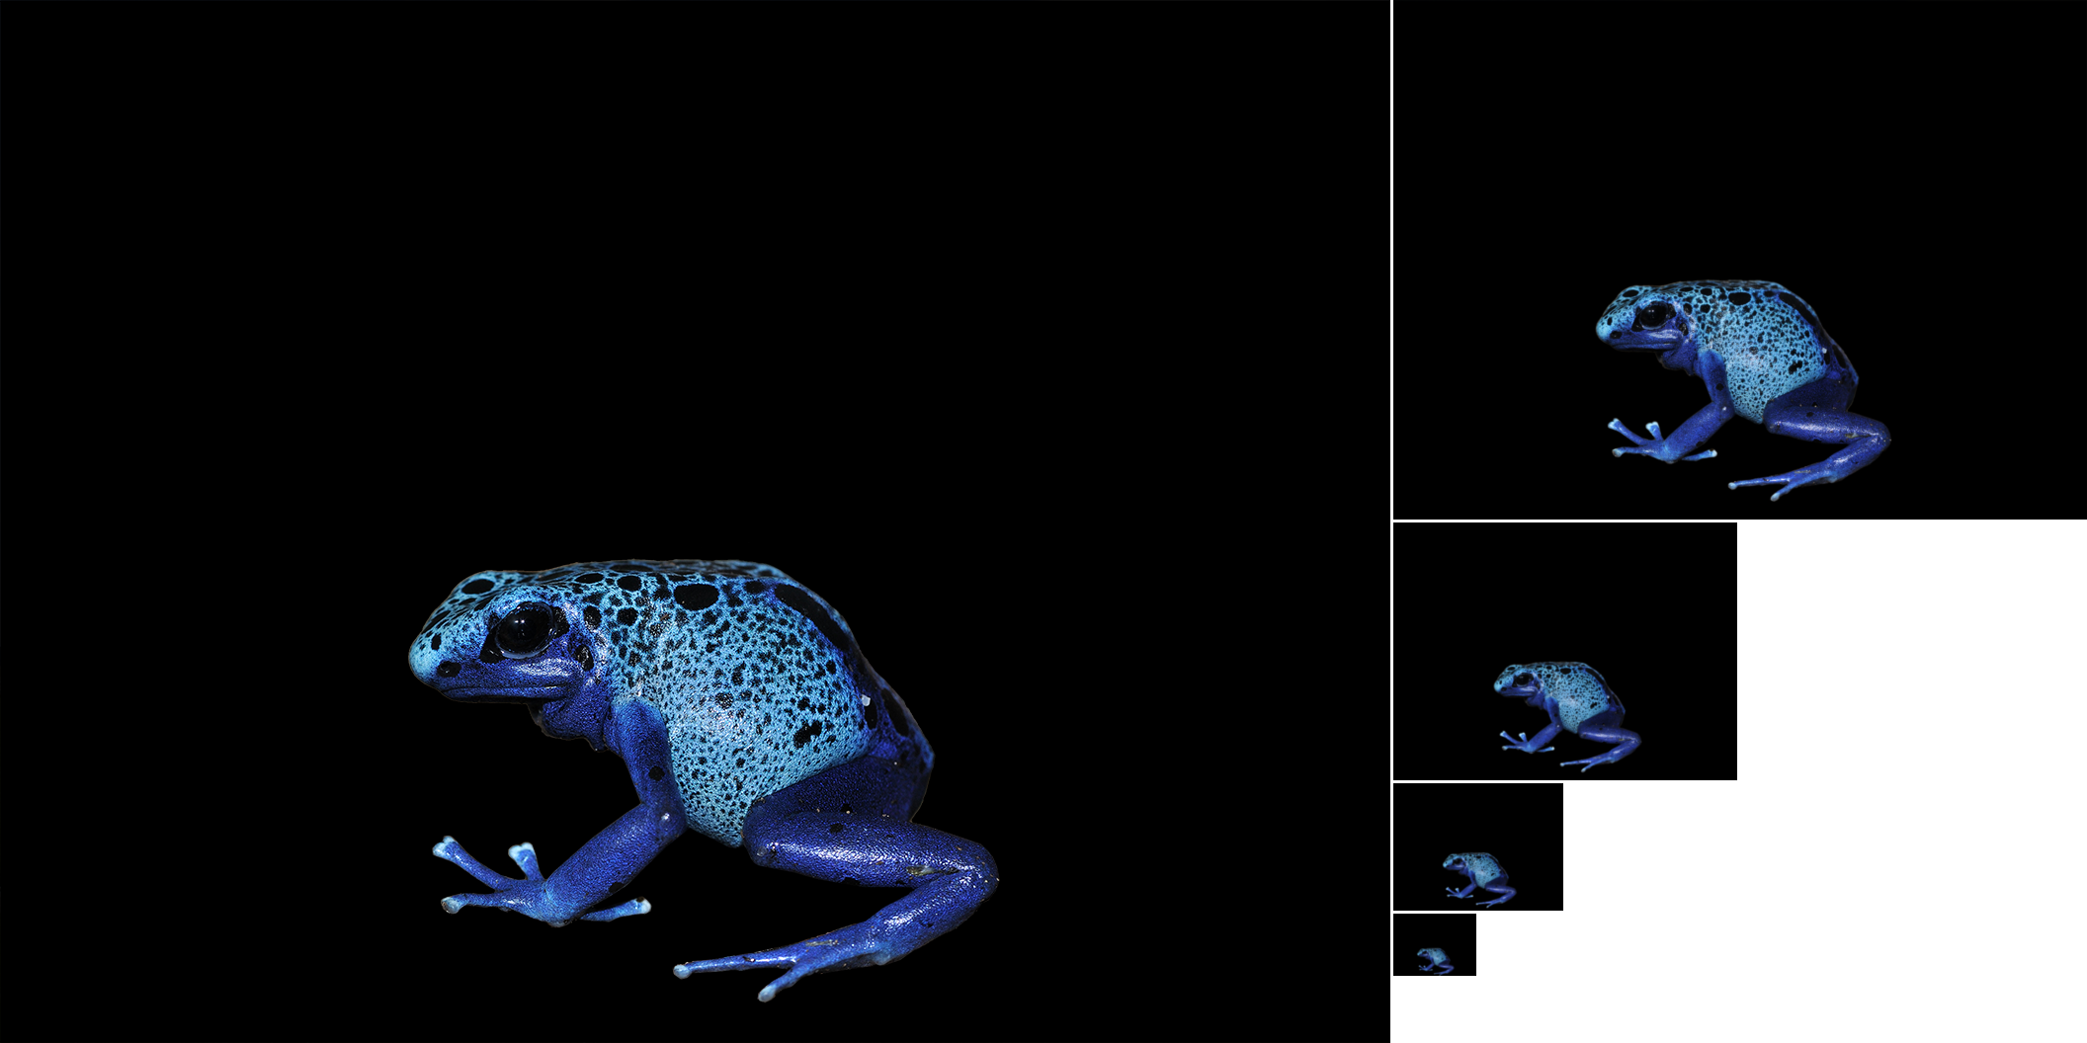
Image Compositing via Resolution Pyramids
Gaussian resolution pyramid

Slide 8
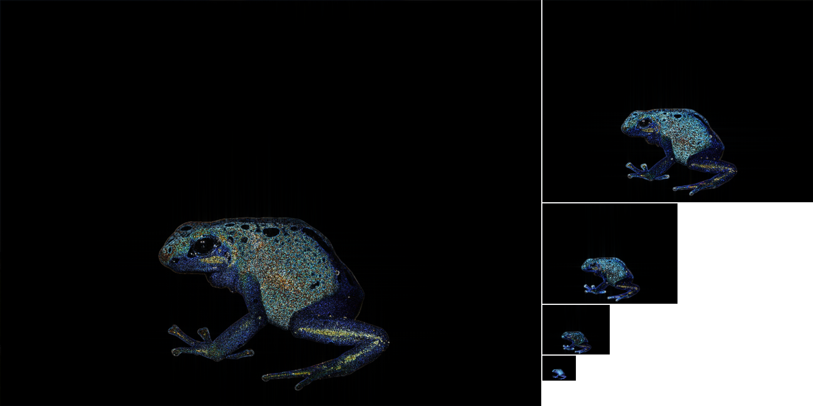
Image Compositing via Resolution Pyramids
Laplacian pyramid

Slide 9
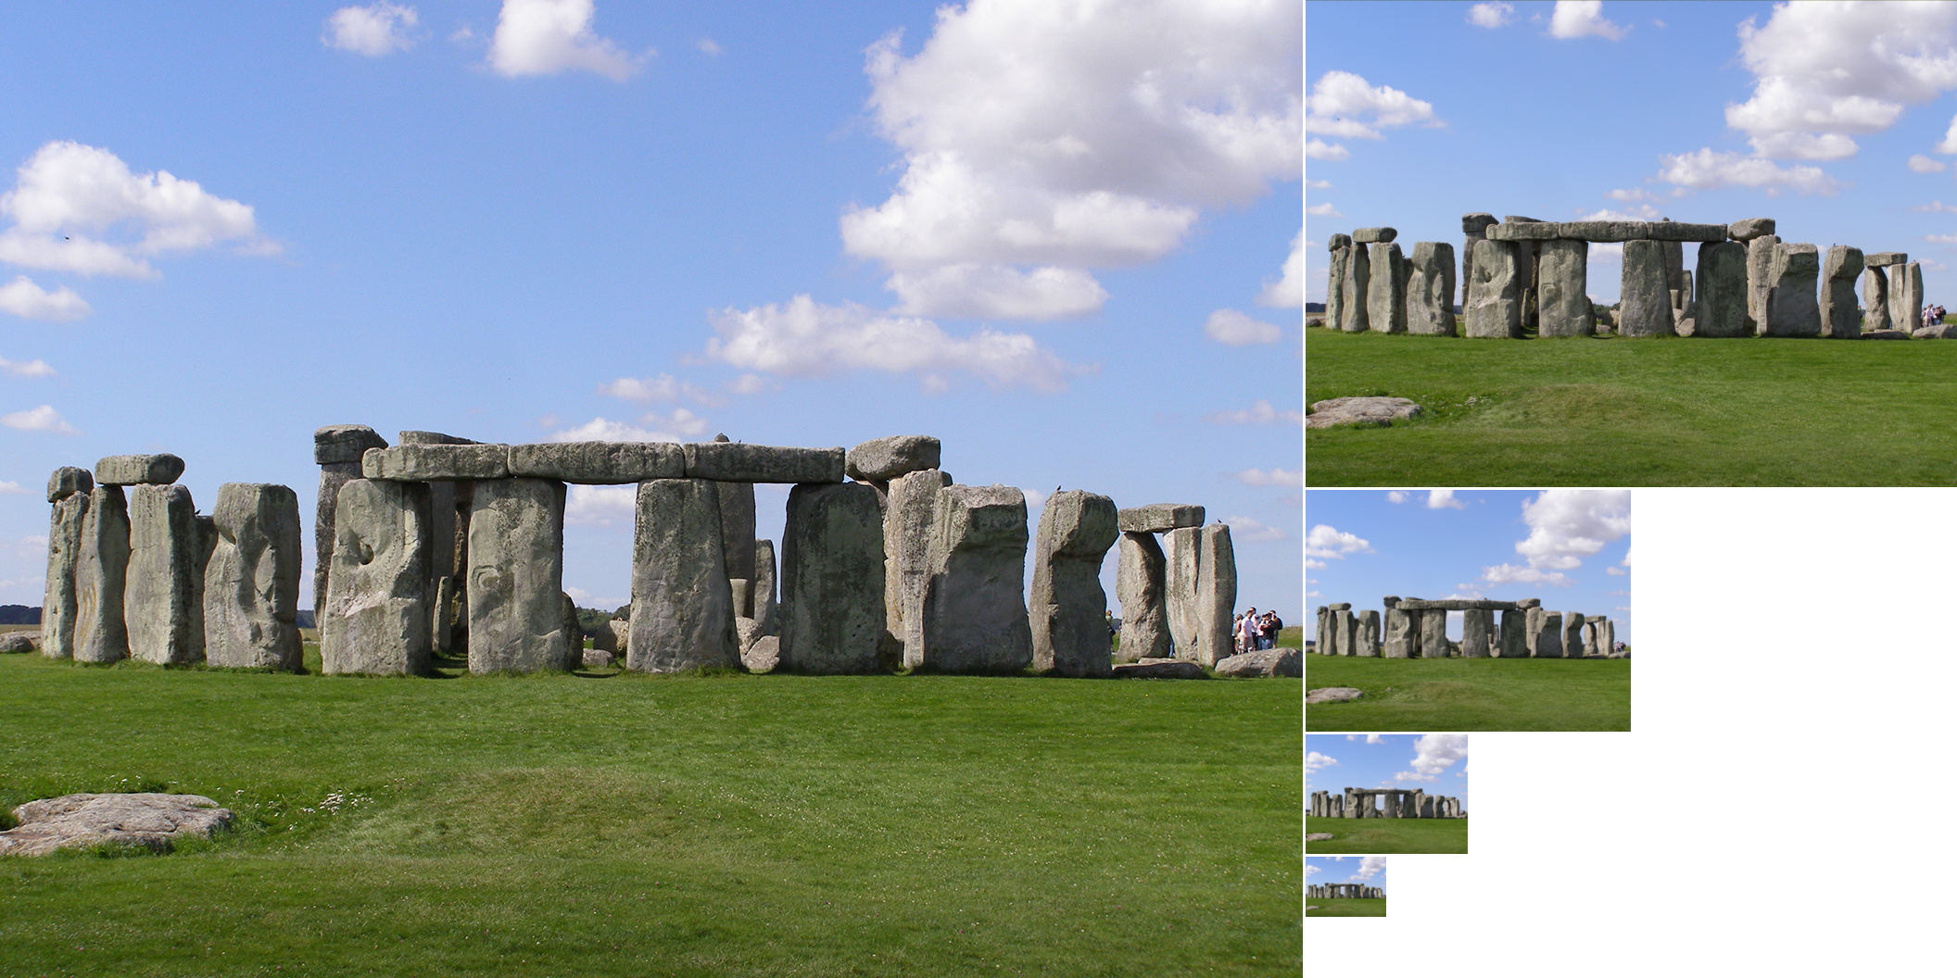
Image Compositing via Resolution Pyramids
Gaussian resolution pyramid

Slide 10
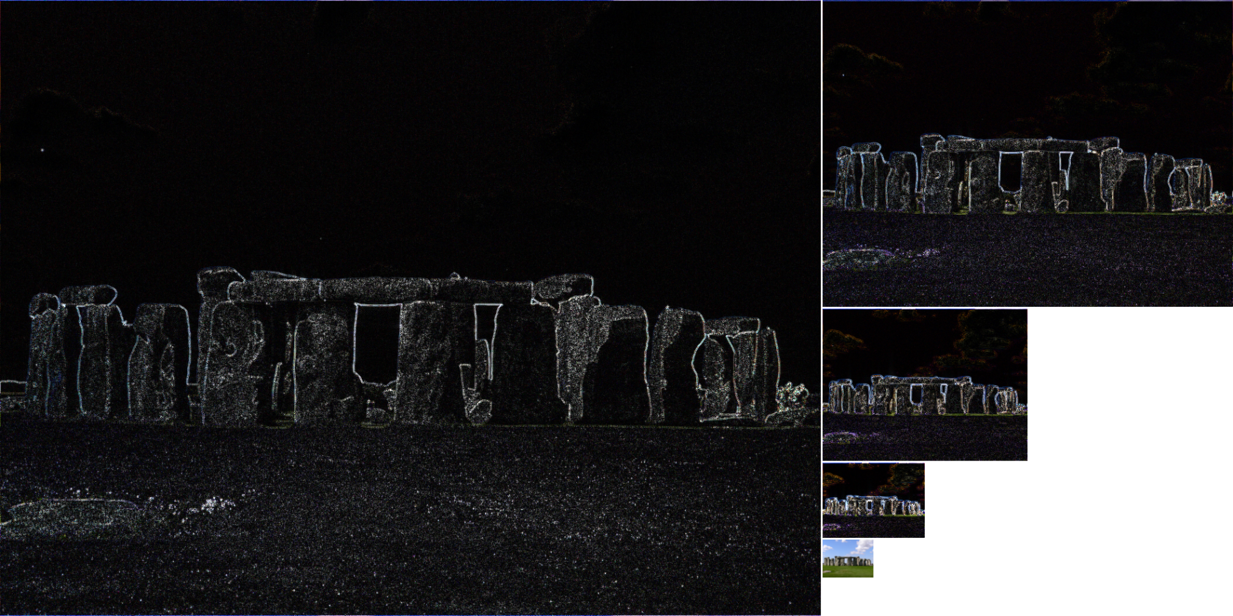
Image Compositing via Resolution Pyramids
Laplacian pyramid

Slide 11
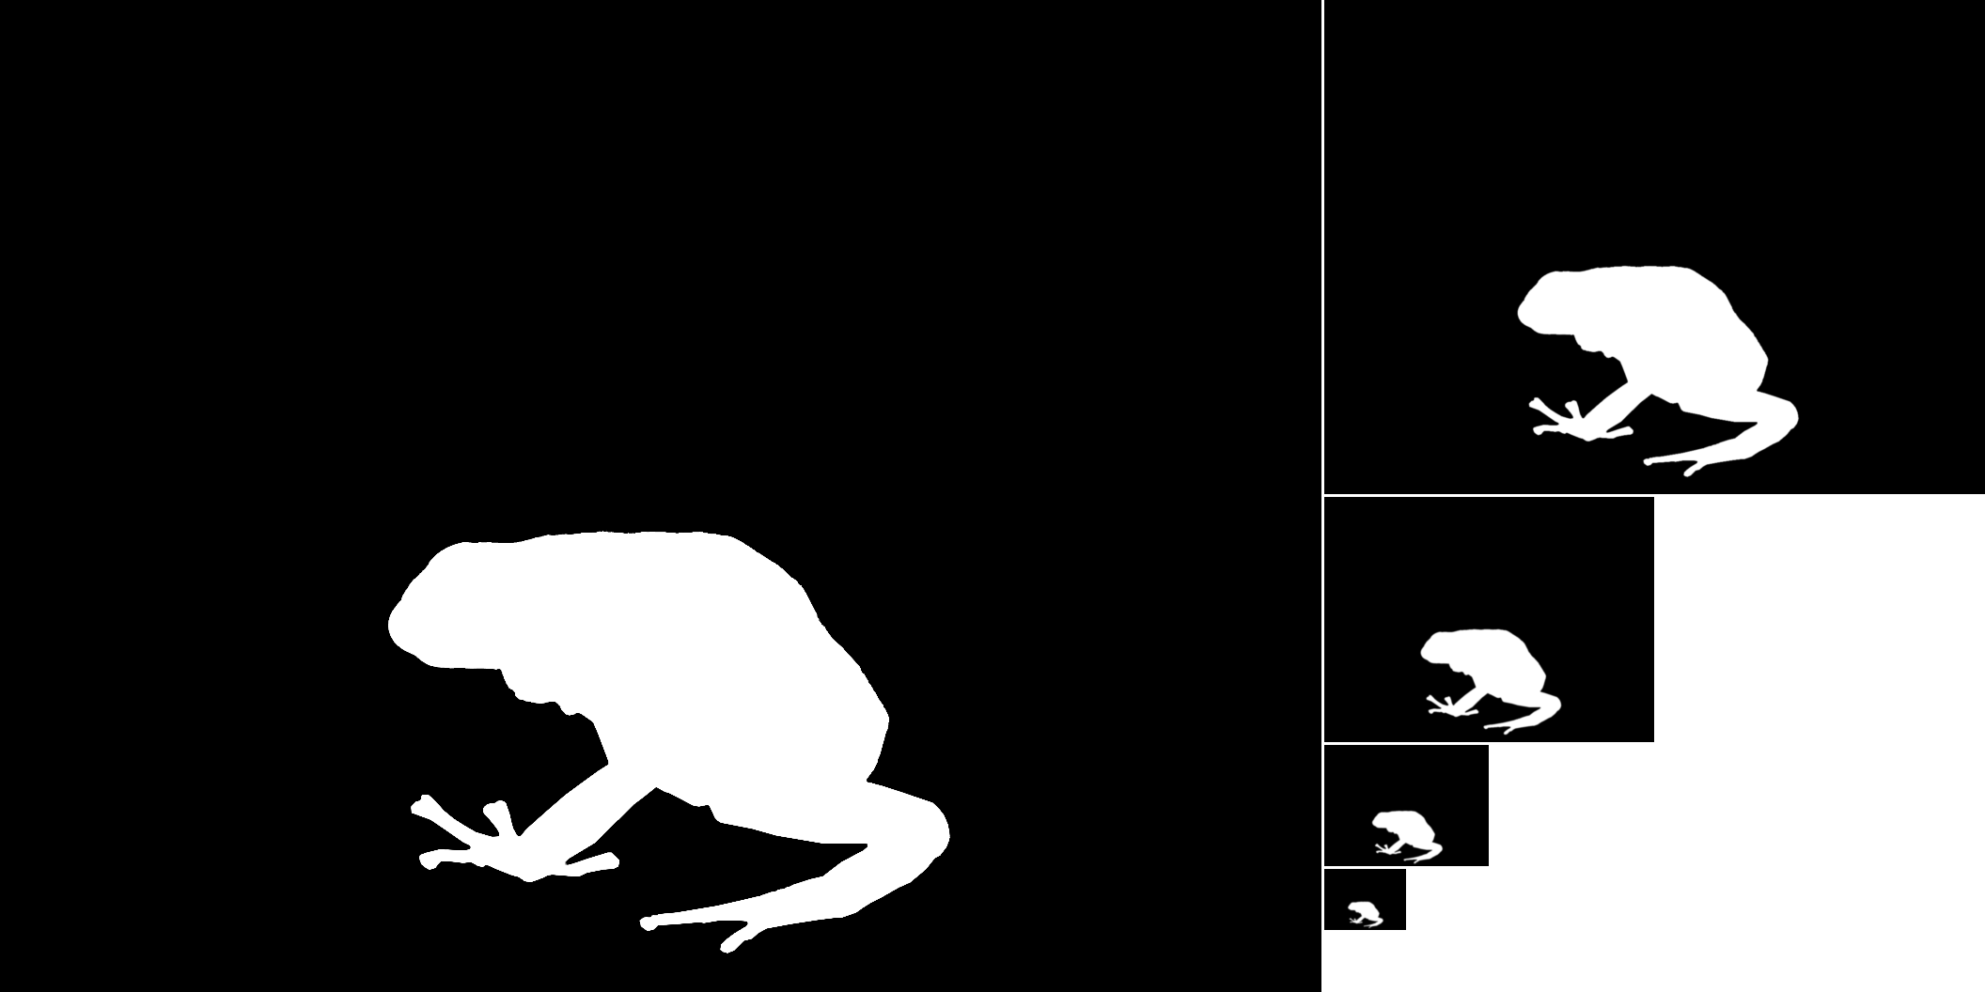
Image Compositing via Resolution Pyramids
Gaussian resolution pyramid

Slide 12
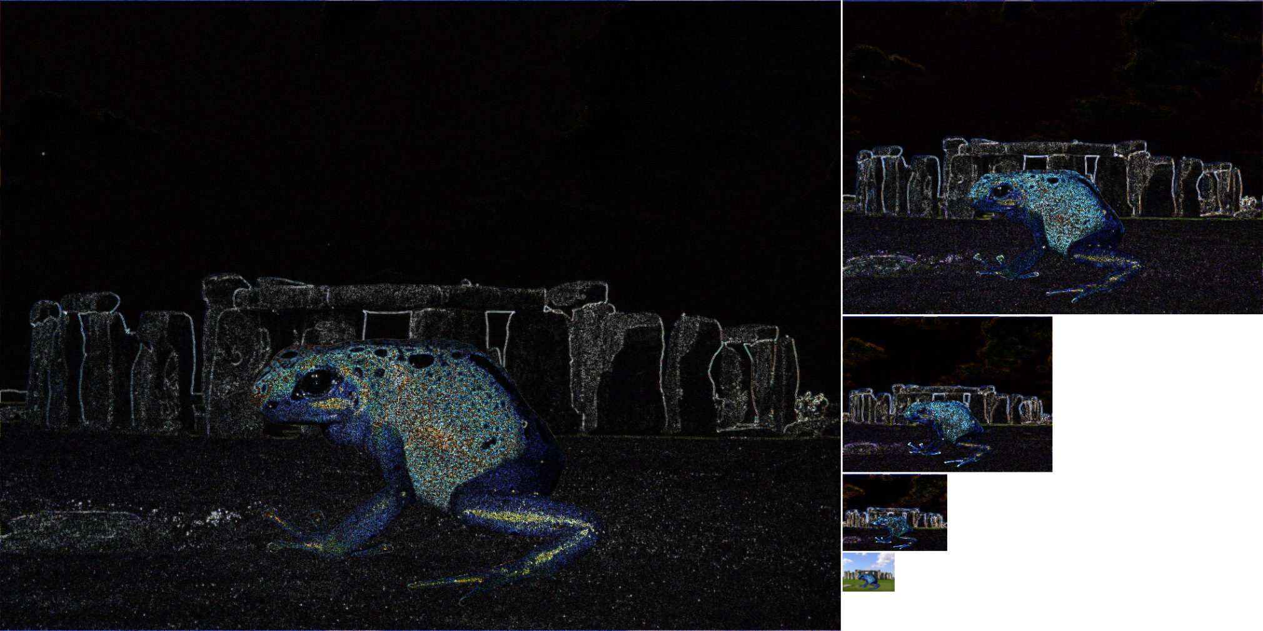
Image Compositing via Resolution Pyramids
Composite Laplacian pyramid

Slide 13
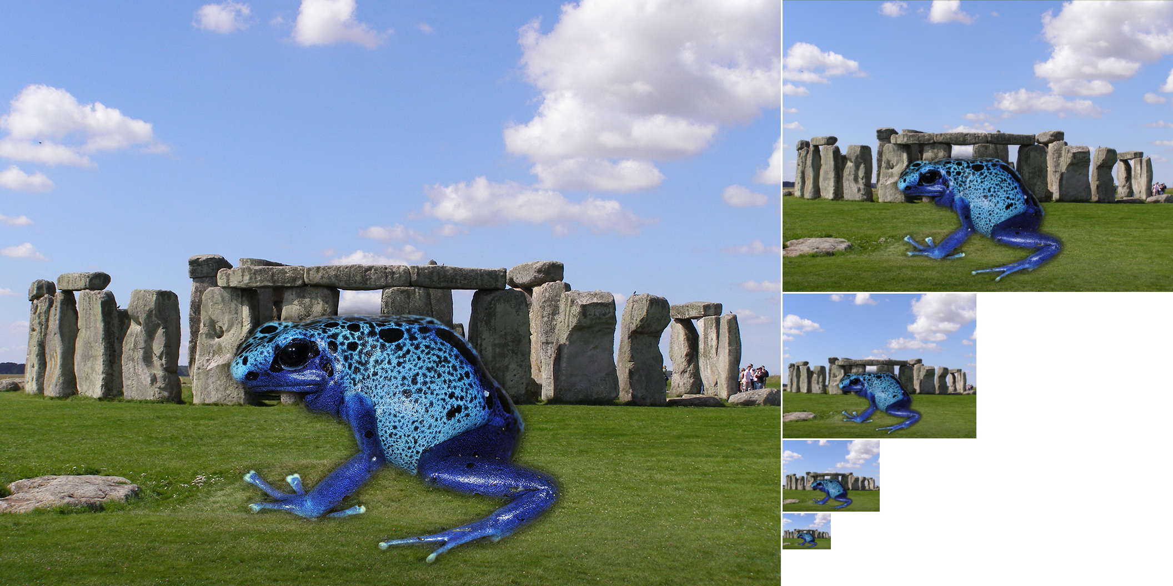
Image Compositing via Resolution Pyramids

Slide 14

Image Compositing via Resolution Pyramids
Final composite image.

Slide 15
Image Compositing via Resolution Pyramids
Simple overlay.

